Slide 1


Introduction to Viral Rumors Detection
Viral Rumors is a growing problem in our digital age, spreading misinformation and undermining trust in media. Machine learning offers powerful tools to identify and combat this threat, with advanced techniques to analyze content, source reliability, and user engagement patterns.

Slide 2
Defining Viral Rummors
Viral Rummors refers to deliberately fabricated or misleading information presented as legitimate news. These stories are often designed to influence public opinion, promote a specific agenda, or generate financial gain through increased engagement and ad revenue.
Distinguishing fake news from factual reporting can be challenging, as it may appear credible and be shared widely on social media platforms. Identifying the source, verifying claims, and fact-checking the content are essential steps in detecting fake news.

Slide 3

Abstract
Viral Rumor has become one of the major problems in the existing society. Fake News has high potential to change opinions, facts and can be the most dangerous weapon in influencing society.
The proposed project uses NLP techniques for detecting the 'fake news', that is, misleading news stories which come from non-reputable sources.

Slide 4

Existing System
Currently, the process of detecting viral rumors relies heavily on manual fact-checking by human experts. This approach is time-consuming, subjective, and often limited in its reach. Existing systems struggle to keep up with the rapid spread of misinformation across digital platforms.
Traditional methods of viral rumor detection, such as keyword-based filtering and rule-based classification, have proven to be ineffective in the face of increasingly sophisticated disinformation tactics. The need for a more robust and scalable solution is evident.

Slide 5


Proposed System
To address the issue of viral rumor detection, we propose a machine learning-based system that can accurately identify and classify online content as genuine or fake. Our approach leverages advanced natural language processing techniques and a curated dataset of verified news articles and misinformation.

Slide 6

The Rise of Viral Rummors in the Digital Age
The proliferation of social media and the ease of content creation have fueled the rapid spread of misinformation and fake news. 🌍 The digital landscape has become a breeding ground for manipulated narratives, amplified by echo chambers and polarized online communities.
The anonymity and lack of fact-checking on many digital platforms have allowed for the rapid dissemination of fabricated stories. 💻
Clickbait and sensationalized headlines have become common tactics to attract attention and drive engagement, often at the expense of truth. 🔍
Sophisticated AI-powered bots and coordinated disinformation campaigns have further exacerbated the issue, making it increasingly challenging to distinguish fact from fiction. 🤖

Slide 7

Machine Learning Approaches for Viral Rumors Detection
Supervised Learning Techniques: Leverage classification models like Logistic Regression, Support Vector Machines, and Random forest to detect fake news based on linguistic patterns, source credibility, and social engagement signals.
Unsupervised Learning Techniques: Employ Clustering Algorithms and Topic Modeling to identify groups of similar articles and anomalies that may indicate fake news.
Transfer Learning: Adapt pre-trained language models like BERT and GPT-3 to the viral rumor detection task, leveraging their ability to capture semantic and contextual relationships.

Slide 8

Feature Engineering for Viral Rumors Detection
Effective Viral Rumor detection requires carefully engineered features that capture the nuances of deceptive content. Textual features like word choice, sentiment, and readability can reveal patterns in language used to mislead. Social network features like sharing patterns and user profiles also provide valuable signals.
Incorporating multimodal features that analyze images, videos, and audio can further enhance the detection of fake news that combines multiple media types. Ultimately, a rich set of well-crafted features is essential for training robust machine learning models to identify deceptive content.

Slide 9

Challenges in Detecting Viral Rumors
Detecting viral rumor poses significant challenges due to the rapid spread of misinformation online and the evolving techniques used by those who create it. The sheer volume of content shared daily makes it difficult to manually verify the accuracy of every claim.
Additionally, many fake news stories are designed to appear credible, using convincing language, imagery, and even falsified sources to lend them an air of legitimacy. This makes automated detection increasingly complex.

Slide 10

Hardware Requirements
High-performance CPU and GPU for efficient machine learning model training and inference.
Substantial RAM to handle large-scale datasets and complex model architectures.
High-capacity storage (SSD or HHD) for storing training data, model checkpoints, and system logs.

Slide 11

Software Requirements
Python3 or higher: The application will be developed using Python, a popular and versatile programming language.
Jupyter Notebook: It is an open source web application that allows you to create and share documents that contain live code, equations , visualization and narrative text.
Streamlit: Streamlit is an open source python library that makes it easy to create web apps for machine learning and data science projects.

Slide 12
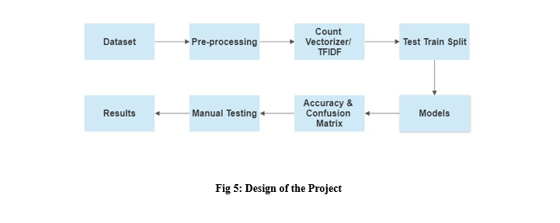
System Architecture
The proposed system architecture consists of a multi-layered approach to detect fake news using machine learning techniques. The core components include data collection, preprocessing, feature extraction, and model training and deployment.

Slide 13
Supervised Learning Techniques
Logistic Regression
Support Vector Machines
Decision Trees
Random Forest
These models build a tree-like structure to make decisions based on article features, providing interpretable results.
Random Forest Builds multiple decision tress during training and outputs the mode of the classes for classification tasks of the average prediction for regression tasks.
A widely used algorithm for binary classification tasks, such as detecting whether an article is fake or not.
Effective in high-dimensional feature spaces, SVMs can capture complex patterns in news content to identify fake articles.

Slide 14
Evaluation Metrics and Benchmarking
Evaluating the performance of fake news detection models requires careful consideration of various metrics. Accuracy, precision, recall, and F1-score are commonly used to assess model effectiveness. Benchmarking against industry-standard datasets, such as PolitiFact and Snopes, allows for comparative analysis and identification of the strongest approaches.
Metric
Description
Importance
Accuracy
The proportion of correct predictions out of total predictions
Measures overall model performance
Precision
The ratio of true positives to total positive predictions
Indicates the model's ability to avoid false positives
Recall
The ratio of true positives to all actual positive instances
Measures the model's ability to identify all true positive cases
F1-Score
The harmonic mean of precision and recall
Provides a balanced measure of model performance

Slide 15

Conclusion and Future Directions
In conclusion, the use of machine learning techniques has proven to be a powerful approach in the fight against the growing challenge of Viral Rumor detection. By leveraging advanced algorithms to analyze content, identify patterns, and detect deception, we can equip both individuals and platforms with the tools to combat the spread of misinformation.
Looking ahead, the future of viral rumor detection lies in the continued refinement and integration of these machine learning models, as well as the exploration of novel approaches that can adapt to the ever-evolving tactics of those intent on spreading false narratives. As we move forward, collaboration between researchers, policymakers, and tech companies will be crucial in staying ahead of this rapidly changing landscape.

